Slide 1
ENGR 12
Dr. Mandala
Notes:
Down

Slide 2
Conference Announcement
Contact and meet with your co-chairs for the sessions you are listed in.
If you haven’t done so already, do it ASAP.
I will begin contacting students who have not made the initial connection with their co-chairs.

Slide 3
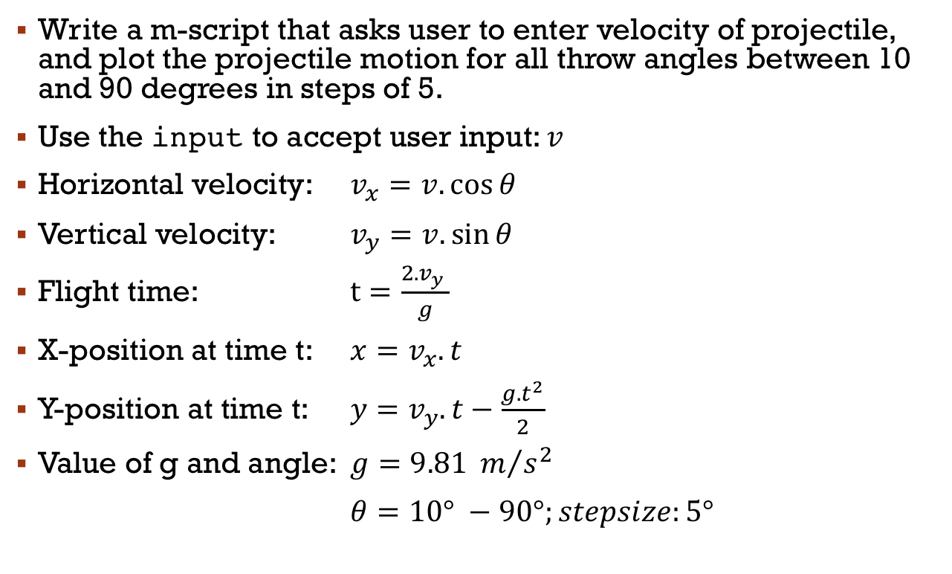
In your teams
Write a m-script that asks user to enter velocity of projectile, and plot the projectile motion for all throw angles between 10 and 90 degrees in steps of 5.
Use the input to accept user input: $v$
Horizontal velocity: $v_{x}=v.\cos{θ}$
Vertical velocity: $v_{y}=v.\sin{θ}$
Flight time: $t=\frac{2.v_{y} }{g}$
X-position at time t: $x=v_{x}.t$
Y-position at time t: $y=v_{y}.t−\frac{{g.t}^{2}}{2}$
Value of g and angle: $g=9.81 m/{s^{2}}$
$θ=10° −90°;stepsize:5°$

Slide 4
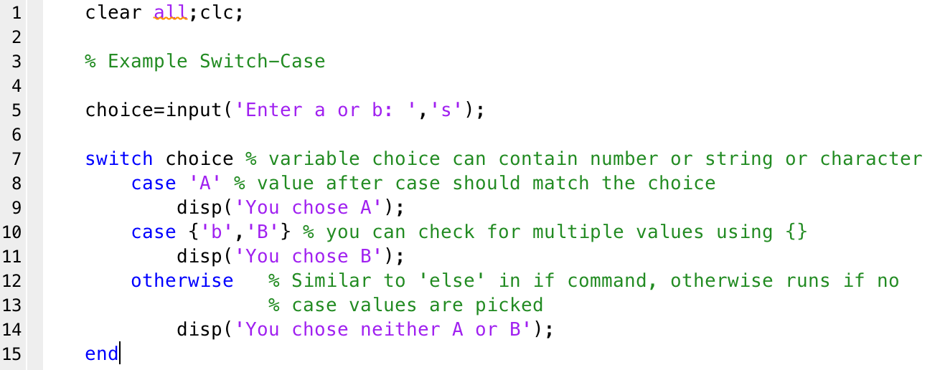
Switch-Case

Slide 5
Modular design
Sub-divide code into smaller snippets or modules that can be developed independently of each other
Modular design with:
Scripts: Not recommended, issues with variable names.
Functions: Preferred method.
See in class example(s).

Slide 6
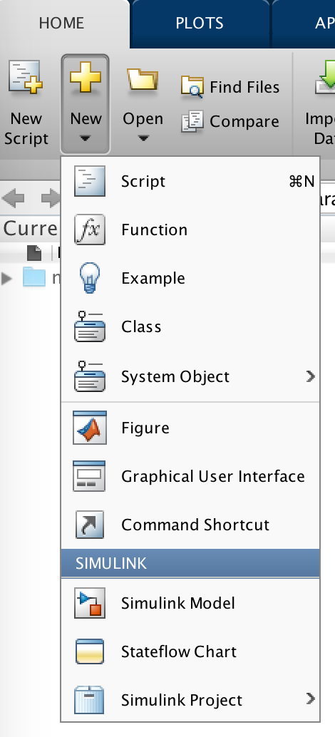
User-defined functions
Option 3: Use MATLAB’s edit command:
>> edit
to open an empty script, or
>> edit file-name.m
to open a script with given file-name that you choose for your function, e.g.,
>> edit myFunc.m
Option 1: Use New Script shortcut
Option 2: Use New > Script shortcut

Slide 7
User-defined functions
Functions look exactly like scripts, but for one difference: functions must have a function declaration
function [x, y, z…] = myFunction(in1, in2, in3…)
Note: MATLAB returns the variables whose names match those in the function declaration. Variables created within the function but not returned disappear after the function stops running
Required MATLAB reserved word
Function name—should match file name i.e; myFunction.m
Function outputs; if more than one, use brackets [ ]
Function inputs

Slide 8
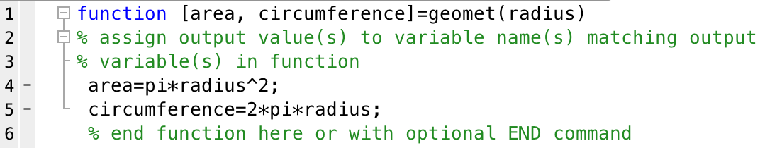
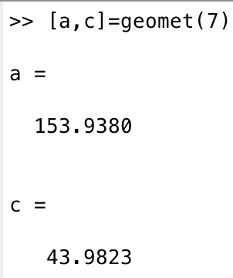
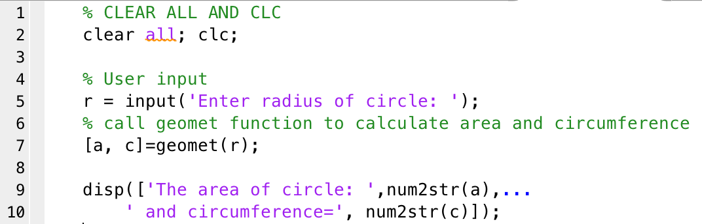
Sample code
Function call either through command prompt or within another MATLAB script

Slide 9
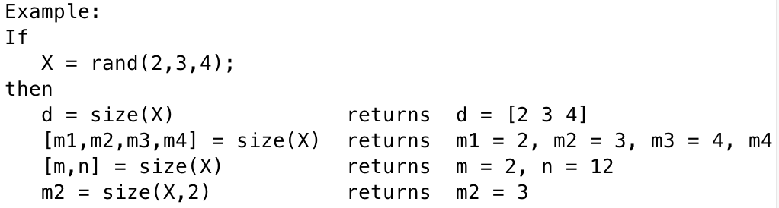
Function overloading
MATLAB allows functions to provide variable output and input i.e. variable number of outputs and inputs.
Example: MATLAB’s builtin SIZE command
Note how the same command is used with different output variable and input variable counts? This is termed overloading.

Slide 10
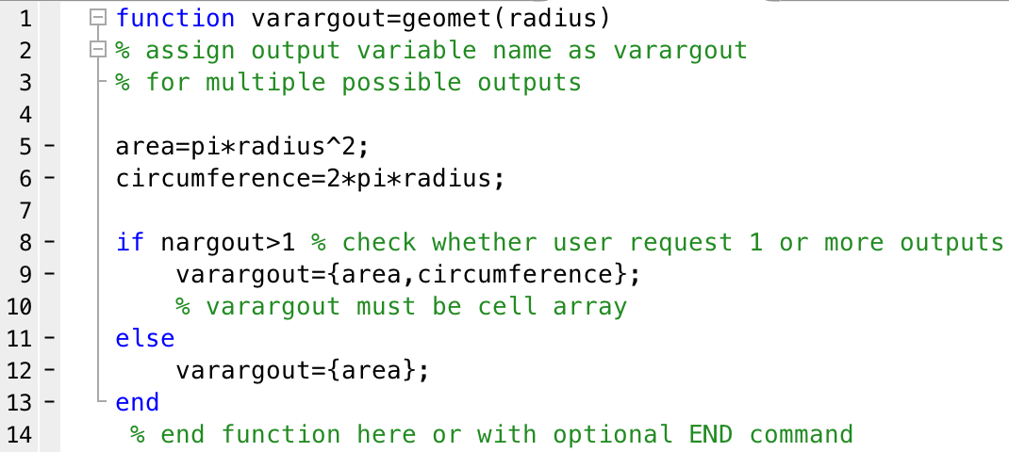
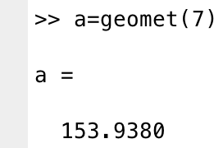
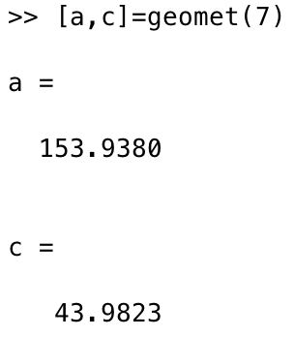
Define overloaded functions

Slide 11
About functions
Functions end at end of file and return values in variables that match output variables in function definition.
You can use an optional END command to define the end of a function.
This becomes required when nesting functions!
You can also use the RETURN command to end the function and return values.
Strategically used to end a function earlier, say, when you detect an error in input.

Slide 12
Download handout
NO Handout.

